Slide 1


Enterprise Application Development
An Introduction to
Java Enterprise Edition
www.JavaCup.ir
Sadegh Aliakbary

Slide 2
Copyright ©2014 JAVACUP.ir
All rights reserved.
Redistribution of JAVACUP contents is not prohibited if JAVACUP is clearly noted as the source in the used case.
JAVACUP shall not be liable for any errors in the content, or for any actions taken in reliance thereon.
Please send your feedback to info@javacup.ir

Slide 3
Outline
Enterprise Application Development
Web Programming
Java Enterprise Edition
  Architectures
  Patterns
  Standards
  Technologies

Slide 4
Static Web Pages
HTML Files
Web Server
Browser
www.abc.com/index.html
index.html

Slide 5
Dynamic Web Pages
Form
Web Server
Browser
Submit Form

Slide 6
Web Application
Definition: A web application is an application delivered to users from a web server over a network such as the Internet
Only needs a web browser to use the application (Thin Client)
  Software application that is coded in a browser-supported language
Common web applications, e.g., webmail, Google Docs, Portals, …

Slide 7
Web Applications Layers
Logical Partitioning → Layering
Common layering in web applications
  Presentation Layer
  Business logic Layer
  Data (management/source) Layer
These layers are purely abstractions
These layers may not correspond to physical distribution (tiers)

Slide 8
Presentation Layer
Handling the interactions between the user and the software
  GUI
  HTML based browser
The user interface of the application
  Can be made up client side & server side codes
It communicates with other layers by outputting results to the browser/client software and all other layers
What is this layer in Facebook?

Slide 9
Business Logic Layer
The work that the application needs to do for the domain
It controls an application’s functionality by performing detailed processing
  Validation of the data from the presentation
  Processing/Computing/Calculations
  Dispatching data source logic
  …
What does this layer do in Facebook?

Slide 10
Data Layer
Communicating with other systems that carry out tasks (typically data retrieval) on behalf of the application
Database server
Files
Transaction monitor
What is this layer in Facebook?

Slide 11
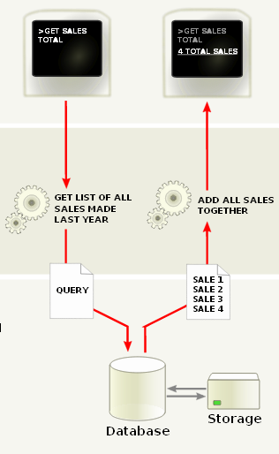
Multilayer Architecture
Presentation Layer
Business logic Layer
Data Layer

Slide 12
Data Layer Trends
New Patterns and technologies in data layer:
Object Databases
ORM
NoSQL
CQRS
Data-warehousing

Slide 13
Client-Server Architecture
Client-Server: The traditional architecture for distributed computing (including web)
Client: Active (master), Sends requests, Awaits response
Server: passive (slave), waits for requests, serves requests and sends a response
Thin client (Pros and Cons?)
  function is mainly presentational
    e.g. standard browser functionality
  All significant processing done by server
Fat client (Pros and Cons?)
  Significant processing on client
    e.g. Java applet, Flash
  less server load

Slide 14
Multitier Architecture
Physical separation of these layers is another story
  Tiers: the physical separation of layers
Three-tier Architecture:
N-tire Architecture:

Slide 15
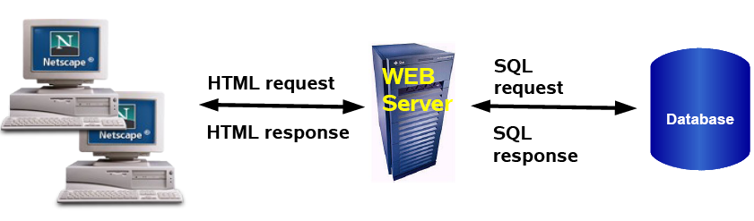
Three-Tier (Web Server)
Browser handles presentation logic
Browser talks to Web server via HTTP protocol
Business logic and data model are handled by “dynamic contents generation” technologies (CGI, Servlet/JSP, ASP)

Slide 16
N-Tier Architecture
In N-tier deployments, presentation layer, business logic layer, and data layer are separated into respective physical tiers
  3 tier: client + server + data base
Presentation layer is implemented by parts in both client & server sides
  E.g., dynamic web page using AJAX + PHP
  4 tier: Browser + Web server + Application Server + Database server
Complicated Bussing logic layer itself can be distributed multitier application → N-tier

Slide 17
Typical Web Application N-tier Architecture
HTML Client (browser)
Web Server
Application Server
Database Server

Slide 18
N-Tier Architecture Characteristics
Migration costs are low
  Business logic application migration
  Database switching
  Web server switch
  OS upgrade
  Each tier can be upgraded independently
Communication performance suffers
Maintenance costs are high

Slide 19
Implementation
Many common requirements in applications
  Transaction, Logging and audit, Security, and much more
These are not implemented by neither OS nor Application developer
  They are called middleware
Application servers provide middleware services
  Application components live inside application servers

Slide 20
Application Servers
Existing technologies can be classified into three broad categories
Java based platform (Java Enterprise Edition)
.NET Framework
Other web application development frameworks
  PHP frameworks: Zend, …
  Ruby on Rail
  …

Slide 21
MVC
What is design pattern?
  Designing complex SW system is really difficult
  Design patterns help us to design in methodological manner
Model-View-Controller (MVC)
  Model
    Contains data, system state, and logic
  View
    Presents data and system state
  Controller
    Handles events/requests affecting model or view

Slide 22
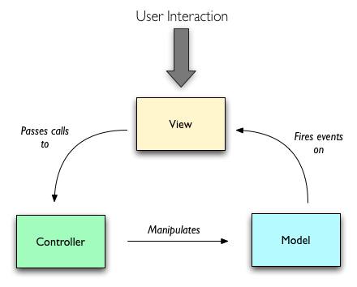
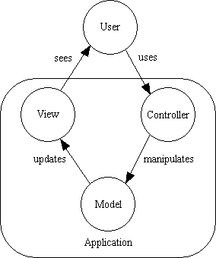
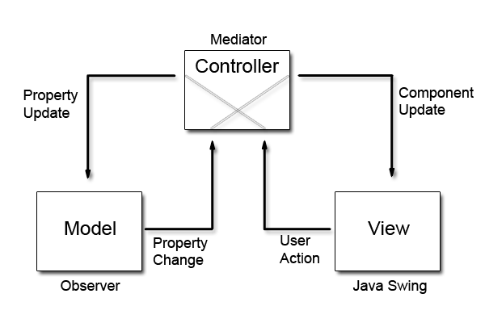
MVC?!

Slide 23
MVC Interactions (cont’d)
model
view queries model
controller updates model
model signals changes
view
controller
controller updates view
event
event is passed to the controller

Slide 24
MVC in Web Applications
Model consists of data and system state
Database tables
  Persistent data
Session information
  Current system state data
Business logic (eCommerce)
  Rules governing the transaction

Slide 25
MVC in Web Applications (cont’d)
View gives a presentation of the model
Client-side presentation in a browser window
  (D)HTML
  CSS style-sheets
  Server-side templates
Administrative information
  Server output logs

Slide 26
MVC in Web Applications (cont’d)
Controller handles events
User-generated events
  Client-side scripting
  HTTP request processing
  Redirection
  Pre-processing
System maintenance
  Web application management

Slide 27
Java Enterprise Edition

Slide 28
The Enterprise Today
Availability 7×24
Robustness
Performance
Extensibility
Security
Responsiveness
Scalability
Integration

Slide 29
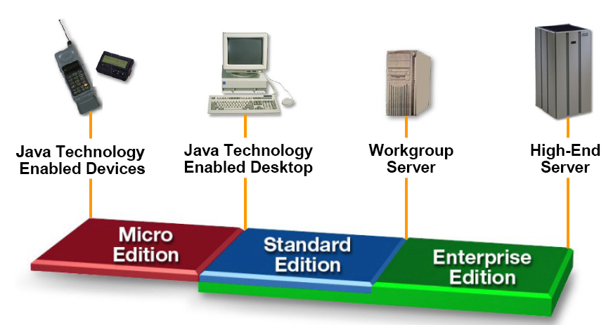
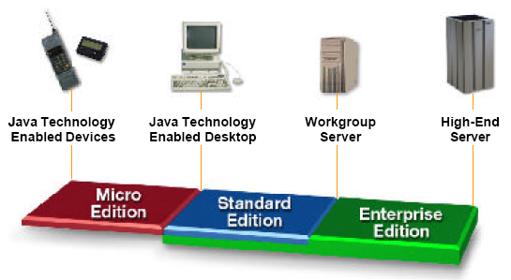
The Java™ Platform

Slide 30
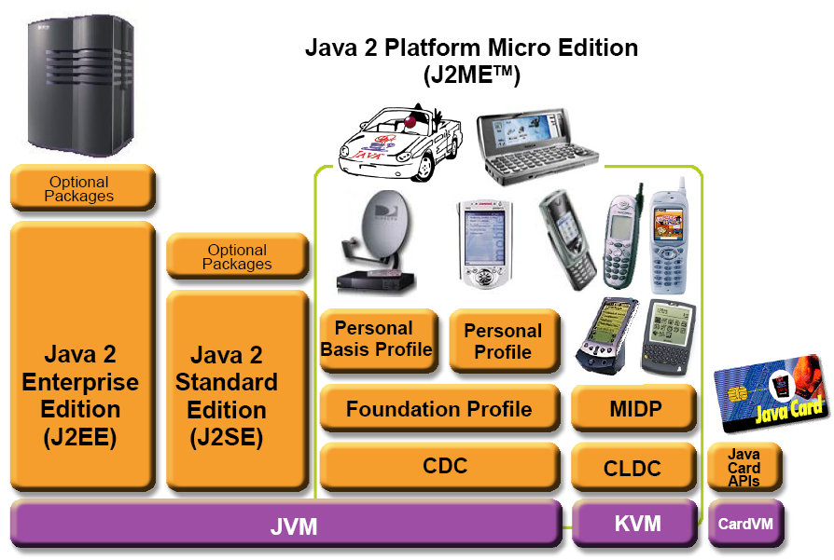
The Java™ Platform

Slide 31
Java EE
Java Platforms
  Java Card: Smart card version
  Java ME (Micro Edition): Embedded systems, e.g. Mobile handheld
  Java SE (Standard Edition): Desktop application development
  Java EE (Enterprise Edition): Enterprise distributed application software
Java EE add standards and libraries to SE for fault-tolerant, distributed, multi-tier based components
  Until java 5, it has been called J2EE

Slide 32
JavaEE
JavaEE platform is a simple, unified standard for distributed applications through a component-based application model
Provides a component-based approach to the design, development, assembly, and deployment of enterprise applications
It’s based on 3⁺-tier Application Architecture

Slide 33
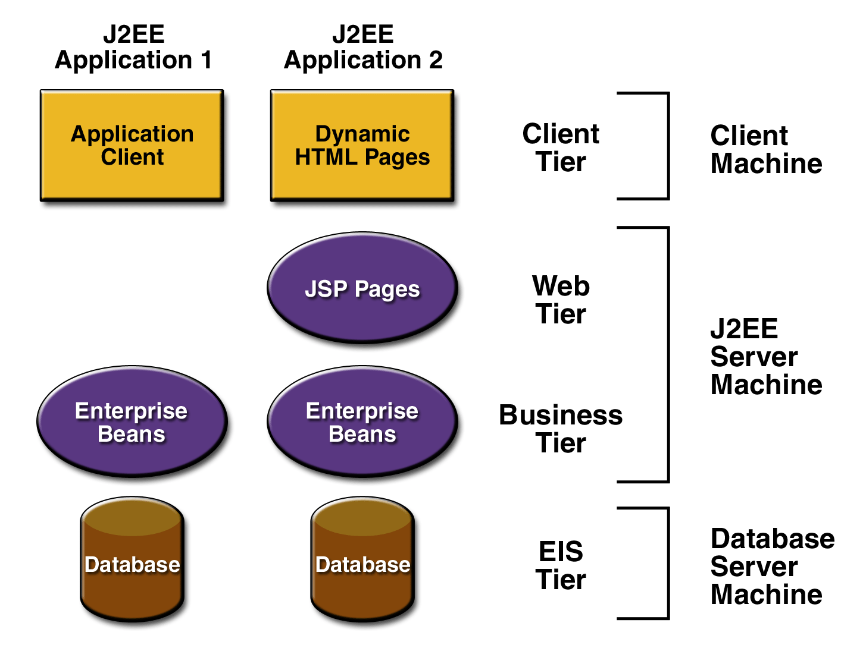
JavaEE Application Architecture
User Interface
Application Logic

Slide 34
J2EE Components
J2EE Client
  Web Client(DHTML,HTML,XML,...)
  Applet
  Application Client
J2EE Server
  Web Component
  Business Component
Enterprise Information System (EIS)
  DBMS,…

Slide 35
Web Client
Web pages containing various types of markup language (e.g. HTML, XML), which are generated by web components running in the web tier
Web Browser
is called thin client

Slide 36
Application Client
It typically has a graphical user interface(GUI) created from Swing or AWT APIs, but a command-line interface is certainly possible.
Application clients directly access enterprise beans running in the business tier
is called thick client

Slide 37
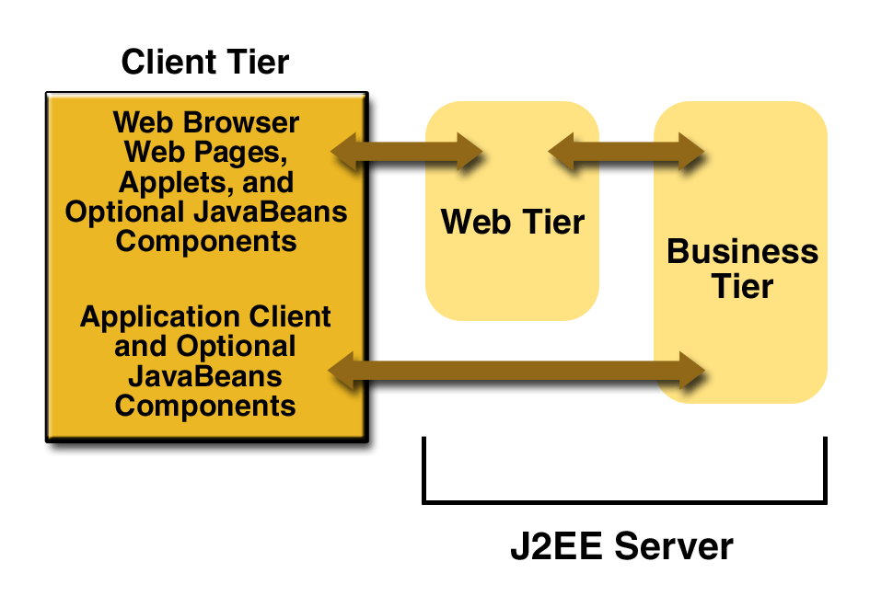
J2EE Server

Slide 38
Java EE
Java EE provides technologies (libraries) for enterprise level applications
Java EE technologies for web applications
  Servlet
  JavaServer Pages
  JavaServer Faces
  Java Enterprise Beans
Many other required libraries
  Remote method invocation, Security, Database connectors, XML, …

Slide 39
Java EE Standards and Technologies
Java API for RESTful Web Services (JAX-RS)
Web Services
Java API for XML-Based Web Services (JAX-WS)
Java Architecture for XML Binding (JAXB)
Java API for XML-based RPC (JAX-RPC)
Java APIs for XML Messaging (JAXM)
Java Servlet
JavaServer Faces (JSF)
JavaServer Pages (JSP)
JavaServer Pages Standard Tag Library (JSTL)
Enterprise JavaBeans (EJB)
Java Persistence API (JPA)
Java EE Connector Architecture
Java Message Service API (JMS)
Java Transaction API (JTA)
JavaMail API
Java Authentication Service Provider Interface for Containers (JASPIC)
Java Authorization Service Provider Contract for Containers (JACC)

Slide 40
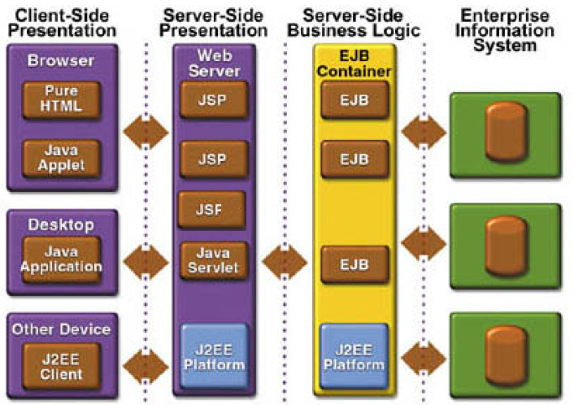
Java EE Multi-tier Architecture

Slide 41
Java EE Container Architecture
Applet Container
Web Container
EJB Container
Applet
Java Servlets
EJBs
JSP
Application Client
Container
JSF
Java EE Application Server
App.Client
Databases and
Other Resources

Slide 42
Containers
Containers provide the runtime support for Java EE applications components
Containers provide a view of the underlying Java EE API to the application components
Java EE application components never interact directly with each other
  They use the protocol and methods of the container for interacting
  Remote Procedure Invocation (RMI)

Slide 43
Java EE Presentation Tier Components
Client side
  Client can use HTML, Java Applet, Java Application, …
Server side
  Servlets are special classes to realize the request-response model (get, post of HTTP)
    External server side code
  JSP is a developer-friendly wrapper over the servlet classes
    Embed server side code
  Faces & Facelets similar to JSP but uses custom tags which can be converted to anything

Slide 44
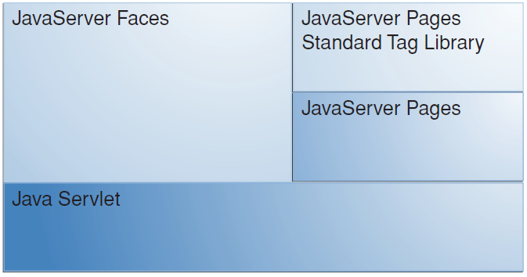
Java EE Presentation Tier Components

Slide 45
Servlet
A Java application run on the web server in response to HTTP GET or POST requests
Servlet is used to generate dynamic content to return to browser: HTML, XML, …
Servlet is a Java program that runs as separated thread inside servlet container
Servlet container is part of web server
  It interacts with web client using the request/ response paradigm
Notes:
Draw a figure to show the architecture!!!

Slide 46
The Servlet Model
HTTP
Get/Post
Browser
Java
Enabled
Web
Server
Servlet
container
Servlet
Servlet
HTML
XML
Resources
JavaBeans
Database

Slide 47
Servlet (cont’d)
Servlet container runs servlets and send back their output to web client
  HTML page is produced by print statements
  out.println("<html>"); …
Loaded into memory once and then called many times
  Performance enhancement
Provides APIs for session management, access to GET/POST data, …

Slide 48
Servlet Implementation
Servlet container provides API for session & request management through implicit objects
  Session object: Session management
  Request object : Access to request fields: headers, cookies, …
  Response object: The response object is used to build the HTTP response
When a request for the servlet is received, the servlet engine spawns a new thread and calls appropriate service method
  doGet: Process HTTP GET requests
  doPost: Process HTTP POST requests
  doDelete, doOptions, doPut, …
destroy() is called by to destroy the servlet
  On web application shutdown or to release some resources
  By default, servlets are kept alive as long as possible

Slide 49
The Hello World Servlet
public class HelloServlet extends HttpServlet {
public void doGet(HttpServletRequest request,
HttpServletResponse response) throws ServletException, IOException {
response.setContentType("text/html");
PrintWriter out = response.getWriter();
_{String docType =}
"<!DOCTYPE HTML PUBLIC \"-//W3C//DTD HTML 4.0 " +
_{"Transitional//EN\">\n";}
_{out.println(docType +}
_{"<HTML>\n" +}
"<HEAD><TITLE>Hello</TITLE></HEAD>\n" +
_{"<BODY>\n" +}
_{"<H1>Hello World</H1>\n" +}
_{"</BODY></HTML>");}
}
}

Slide 50
Servlets vs. CGI Scripts
Advantages:
  Running a servlet doesn’t require creating a separate process each time
  A servlet stays in memory, so it doesn’t have to be reloaded each time
  Untrusted servlets can be run in a “sandbox”
    A secured environment
Disadvantage:
  Servlets must be in Java
  CGI scripts can be in any language

Slide 51
JavaServer Pages (JSP)
JavaServer Pages technology is an extension of servlet
  It is the embed version of servlet in HTML
    JSPs are easier to develop than servlets
  It runs on the web server tier
Contains some static HTML and some JSP tags in .jsp file, Java code inside the tags creates dynamic content (similar to PHP)
When JSP is run, it creates a servlet

Slide 52
JSP Example
<html xmlns = "http://www.w3.org/1999/xhtml">
<head> <title>Processing "get" requests with data</title> </head>
<body>
<% // begin scriptlet
String name = request.getParameter("firstName");
if ( name != null ) {
%>
<h1> Hello <%= name %>, <br /> Welcome to JavaServer Pages! <h1>
<% // continue scriptlet
}
else {
%>
<form action = "welcome.jsp" method = "get">
<p> Type your first name and press Submit</p>
<p><input type = "text" name = "firstName" />
<input type = "submit" value = "Submit" />
</p>
</form>
<% // continue scriptlet
} // end else
%>
</body>
</html>

Slide 53
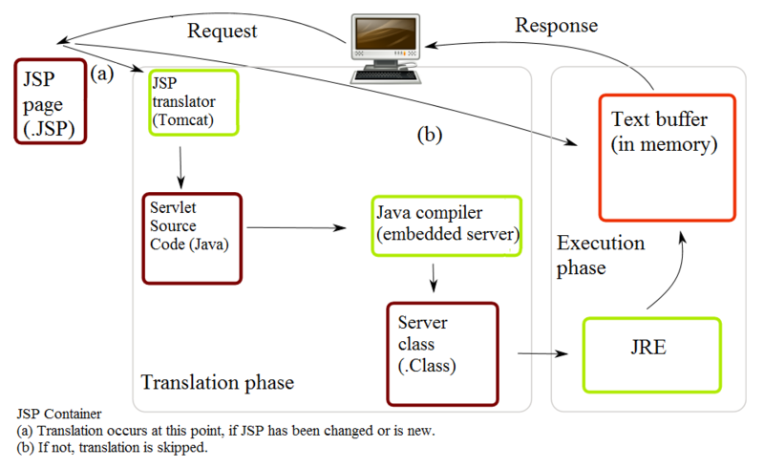
JSP Invocation

Slide 54
JSP Advantages
Performance
  Runtime characteristics of servlet
  Server side complex processing
Programming
  Easier to develop
  Automatic recompilation of modified pages
  More natural way to dynamic web pages

Slide 55
JSP in Summary
In comparison to interpreted scripts (PHP)
  JSP is compiled
    More safety & better performance
  Compiled servlet is in memory
    Better performance
  Converted to Servlet (a complete Java program)
    Full OOP!!
    More complex logic implementation

Slide 56
JavaServer Faces
A user interface framework for building web applications
JavaServer Faces Components
  A GUI component framework
    A set of custom markup tags <h:form>, <h:head>
  A flexible model for rendering components in different kinds of HTML or different markup
    A Renderer object generates the markup to render the component & view its data
  A standard RenderKit for generating HTML/4.01

Slide 57
JavaServer Faces Components
Backing beans
  The logic of application
    Java classes using Java EE beans
Facelet
  The view of application
    XHTML file using component tags
Application configuration & description
  Mapping between Facelets & Beans
  File organization, …

Slide 58
EJB
EJBs are distributed components used to implement business logic (no UI)
Developer concentrates on business logic
  Availability, scalability, security, interoperability and … handled by the J2EE server
Client of EJBs can be JSPs, servlets, other EJBs and external applications
Clients see interfaces

Slide 59
EJB Types
Session Beans
  Synchronous Action: Process oriented service providers
  Example: Credit Authorization
Entity Beans
  Data: Represent data
  Example: Customer, Account
Message-Driven
  Asynchronous Action: Never called directly, only receive messages
  JMS
  Example: Transaction logging

Slide 60
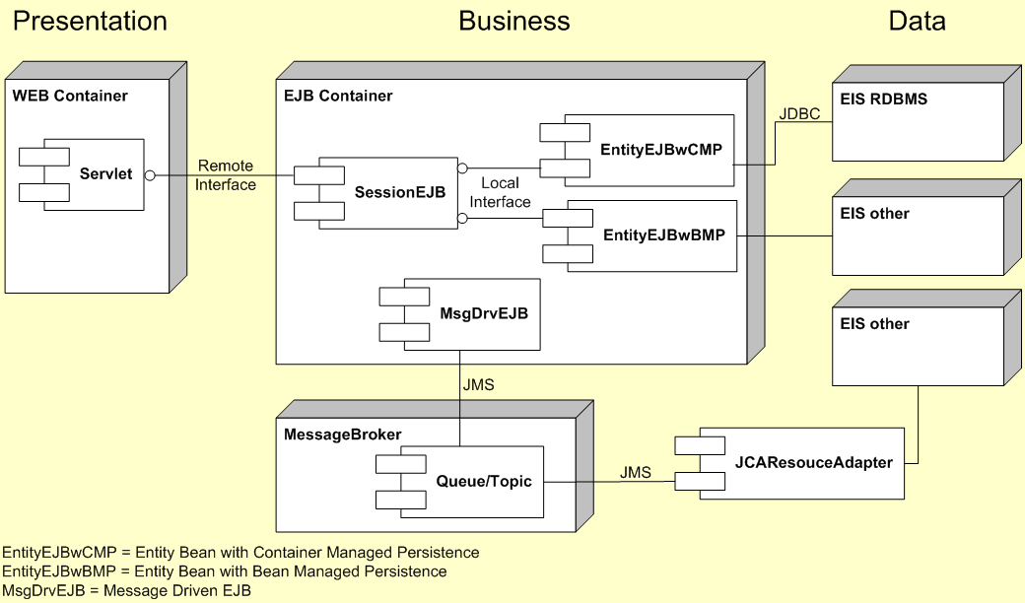
EJB Types

Slide 61
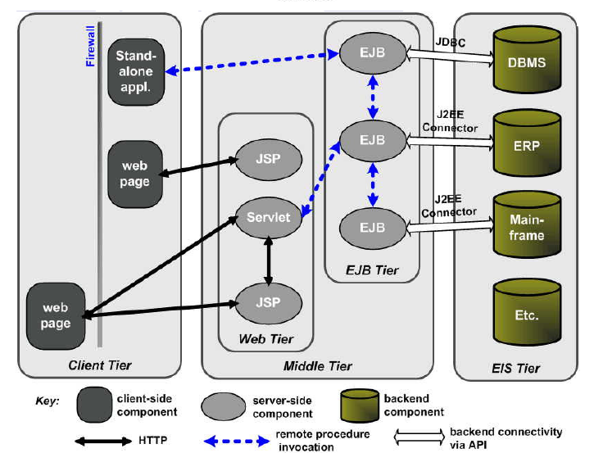
Java EE Summary

Slide 62
MVC in Java EE: Approach 1
The pure JSP approach
Separate JSP pages are used for the controller and the view
Beans being used for the model part
This is a good approach when the development is heavy in graphic designers and light in Java programmers
Relatively complex applications can be constructed with the use of only JSP
  Is also well suited for prototyping Web applications

Slide 63
MVC in Java EE: Approach 2
A combination of servlets, JSP, and beans
A servlet accepts requests and implement business logic
  The servlet that receives requests can use other servlets to handle various kinds of requests
Beans store and perform basic data manipulation
JSP implements the user views of results of requests

Slide 64
MVC in Java EE: Approach 2
Use servlets to implement the controller
JSP to implement the view
Enterprise Java-Beans (EJBs) for the model
This is clearly the most complex of the three approaches and is usually used only for the more sophisticated and complex Web applications

Slide 65
Application Server vs. Servlet Container
A servlet-container supports only the servlet API
  including JSP, JSTL
  e.g. Apache Tomcat
An application server supports the whole JavaEE
  EJB, JMS, JTA, Servlets, etc.
  E.g. JBoss

Slide 66
Servlet Containers
Apache Tomcat
Jetty
  Eclipse foundation

Slide 67
Application Servers
Apache Geronimo
  Tomcat or Jetty as the servlet container
JBoss
  An embedded Apache Tomcat
  JBoss, Red Hat
WebLogic
  BEA => Oracle
GlassGish
  Sun => Oracle
  The reference implementation of Java EE
  A derivative of Apache Tomcat as the servlet container
Websphere
  IBM

Slide 68


Oracle, BEA, Sun, …

Slide 69
A closer look at JSP and Servlet
(more practical)

Slide 70
JSP Scripting Elements
There are four types of scripting elements defined
  Declaration
  Expression
  Scriptlets
  Comments

Slide 71
Declaration
Declares a variable or method valid in the scripting language used in the JSP page.
JSP Syntax
<%! declaration; [ declaration; ]+ ... %>
XML Syntax
<jsp:declaration>
code fragment [ declaration; ]+ ...
</jsp:declaration>
Examples
<%! int i = 0; %>
<%! int a, b, c; %>
<%! Circle a = new Circle(2.0); %>

Slide 72
Expression
JSP Syntax
<%= expression %>
XML Syntax
<jsp:expression> expression </jsp:expression>
Description
An expression that is converted to a String
Example
Welcome, <%=userName%>
Output:
Welcome, James

Slide 73
Expression
<%= new java.util.Date()%>
The resulting servlet code will probably look like this:
out.print(new java.util.Date());

Slide 74
Script lets
Contains a code fragment valid in the page scripting language.
Scriptlets allows you to include a series of java statements inside the _jspService method that are executed on every request to the page.these java stmts are incorporated into _jspService method as it is.so you must terminate them with semicolon.
JSP Syntax
<% code fragment %>
OR
<jsp:scriptlet> code fragment </jsp:scriptlet>

Slide 75
Scriptlets
Examples
<% String name = null;
if (request.getParameter("name") == null) { %>
<%@ include file="error.html" %>
<% }
else {
userObject.setName(request.getParameter("name"));
}
%>

Slide 76
Comments
To denote any lines you want to be completely ignored by the JSP translation process.
Example
<%-- Author: James Gosling --%>

Slide 77
taglib directive
Defines a tag library and prefix for the custom tags used in the JSP page.
JSP Syntax
<%@ taglib {uri="URI" | tagdir="/WEB-INF/tags[/subdir]+"} prefix="tagPrefix" %>
Examples
<%@ taglib uri="http://www.jspcentral.com/tags" prefix="public" %>
<public:loop> ... </public:loop>

Slide 78
TagLib
The taglib directive
Declares that the JSP page uses custom tags
Names the tag library that defines them
and specifies their tag prefix.

Slide 79
taglib Directive
Attributes
uri="URI"-
The Uniform Resource Identifier (URI) that uniquely locates the TLD that describes the set of custom tags associated with the named tag prefix.
Prefix=‘tagprefix’
The prefix that precedes the custom tag name, for example, public in <public:loop>. Empty prefixes are illegal.
You cannot use the tag prefixes jsp, jspx, java, javax, servlet, sun, and sunw, as they are reserved by Sun Microsystems.

Slide 80
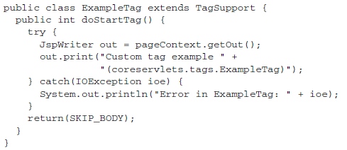
Tag Handler Class
extends the TagSupport or BodyTagSupport class

Slide 81
Tag Library Descriptor (TLD)
By means of a tag library descriptor file (in XML format)
  to identify the class to the server
  and to associate it with a particular XML tag name.

Slide 82
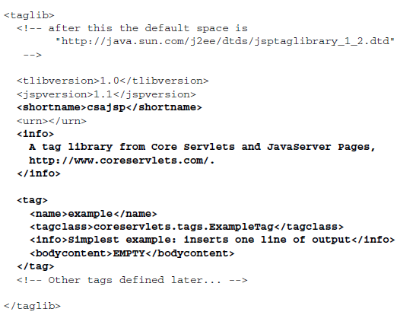
TLD example

Slide 83
JSP Implicit objects
Implicit objects are being created by JSP mechanism automatically. They are accessible from the JSP pages and provides interaction with and information about underlying servlet environment. They are:
page – an instance of implementation class of the JSP; it has the same functionality like Java pointer this;
request – represents the HTTP request, which is being serviced by the JSP page; it is an instance of a class, implementing javax.servlet.http.httpServletRequest interface;
response – represents the HTTP response, receiving by the JSP page; it is an instance of a class, implementing javax.servlet.http.httpServletResponse interface;
pageContext – an object, representing the JSP page context; it is provided for storage and access for all objects having scope page and belonging to an page;
session – an instance of javax.servlet.http.HttpSession, representint an HTTP session;

Slide 84
JSP Implicit objects (cont.)
application – represents the servlet context for the Web application; it is instance of javax.servlet.ServletContext class;
out – instance of javax.servlet.jsp.JspWriter class, which is being used to write content in the JSP output;
config – represents the servlet configuration for a JSP page; instance of javax.servlet.ServletContig;
exception – an object accessible in error pages only; it represents the last exception caught by the JSP; it is instance of java.lang.Exception class;

Slide 85
New Presentation-layer Technologies
Nowadays, enterprise applications usually use other technologies in presentation layer
JSF, GWT, Wicket, …
But we should know the architecture of JSP/Servlets
Many technologies are built on servlet
Servlet concepts are still important and useful

Slide 86
Exercise
Write a simple JSP file
Deploy it on Tomcat
See how it works
See the translated Servlet
See the tomcat folders and files

Slide 87
Review some concepts
Request/Response
  request.getParameter()
  request.getAttribute()
  request.setAttribute()
    Why?!
    Forwarding requests
Session/Application (ServletContext)
  Share variables
  getAttribute/setAttribute
Redirect/Forward

Slide 88
Getting Information From Requests
Parameters
  used to convey information between clients and servlets
  String bookId = request.getParameter("Add");
Object-valued attributes
  used to pass information between the servlet container and a servlet or between collaborating servlets
  request.setAttribute(“id”,theObject);
  Object identifier = request.getAttribute(“id”);

Slide 89
Getting Information From Requests (cont)
Information about
  the protocol
  The method (get, put, …)
  Request path
  Headers
  Query String
  …

Slide 90
Constructing Responses
Indicate the content type
  response.setContentType("text/html");
Indicate whether to buffer output
  By default, any content written to the output stream is immediately sent to the client
  response.setBufferSize(8192);
Retrieve an output stream
  To send character data, use the PrintWriter returned by the response's getWriter method
  To send binary data in a MIME body response, use the ServletOutputStream returned by getOutputStream
Using Output stream
  output.println("<html>“);

Slide 91
Invoking Other Web Resources
To invoke a resource available on the server that is running a web component, you must first obtain a RequestDispatcher using the getRequestDispatcher("URL") method
To include another resource, invoke the include method of a RequestDispatcher:
  include(request, response);

Slide 92
Transferring Control to Another Web Component
public class Dispatcher extends HttpServlet {
public void doGet(HttpServletRequest request,
HttpServletResponse response) {
request.setAttribute("selectedScreen",
request.getServletPath());
RequestDispatcher dispatcher = request.
getRequestDispatcher("/template.jsp");
if (dispatcher != null)
dispatcher.forward(request, response);
}
public void doPost(HttpServletRequest request,
...
}

Slide 93
Web Context
The context in which web components execute is an object that implements the ServletContext interface
We can retrieve the web context with the getServletContext() method

Slide 94
Session: Maintaining Client State
Sessions are represented by an HttpSession object
You can access a session by calling the getSession() method of a request object

Slide 95
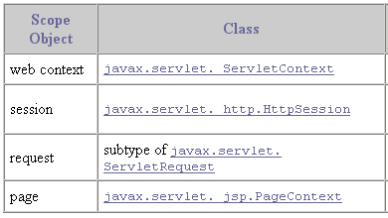
Using Scope Objects
Collaborating web components share information via objects maintained as attributes of these scope objects.
These attributes are accessed with the [get|set]Attribute methods

Slide 96
Servlet Container Folder Structure
bin
  startup
conf
  server.xml
lib
logs
temp
webapps
work
War files

Slide 97
A web-app Structure
Html, css, js, JSPs
WEB-INF
  web.xml
  classes
  lib

Slide 98
web.xml
An xml file
Contains
  Servlet definitions
  Servlet-mappings
  Filter definitions
  Filter-mappings
  Error-pages
  …

Slide 99
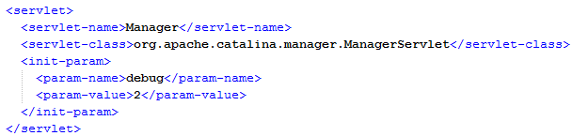
web.xml => servlet

Slide 100

web.xml => servlet-mapping

Slide 101
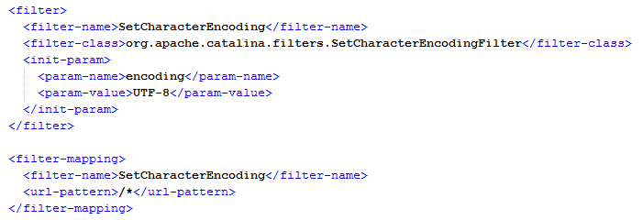
web.xml => filter

Slide 102
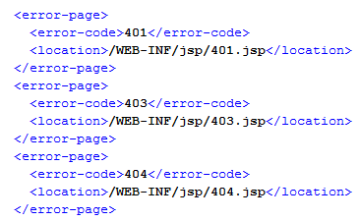
web.xml =>error pages

Slide 103
Filter
Acts as preprocessor to request/response for target servlet
Applications?
  Authentication
    SSO
  Statistics
  Log
  …

Slide 104
Filter Servlets
…HttpPage
PageHits
Filter
Servlet
HttpPage Servlet
Authenticate
Filter
Servlet
…VerifyData
VerifyData Servlet

Slide 105
Filter Servlet
Import java.io.*;
import javax.servlet.*;
import javax.servlet.http.*;
publc class PageHits extends HttpServlet implements Filter
{
private FilterConfig filterConfig = null;
public void init(FilterConfig filterConfig) throws ServletException
{
this.filterConfig = filterConfig;
}
public void destroy(
{
this.filterConfig = null;
}
implement
Filter Interface
override init. method
override destroy method

Slide 106
Filter Servlet (cont.)
public void doFilter(HttpServletRequest request, HttpServletResponse response,
FilterChain chain) throws IOException, ServletException
{
if (filterConfig == null)
return;
synchronized (this)
{
Integer counter =(Integer) filterConfig.getServletContext().getAttribute("Counter");
if (counter == null)
counter = new Integer(0);
counter = new Integer(counter.intValue()+1);
filterConfig.getServletContext().log("Number of hits is " + counter);
filterConfig.getServletContext().setAttribute("Counter", counter);
}
chain.doFilter(req, resp)
}
Must override doFilter method

Slide 107
Modify Deployment Descriptor
<?xml version=“1.0” encoding=“UTF-8:?>
<<!DOCTYPE web-app PUBLIC ‘-//Sun Microsystems, Inc.//DTD Web Application 2.3//EN’
‘http://java.sun.com/dtd/web-app_2_3.dtd’>
<web-app>
<display-name>A Simple Application</display-name>
<servlet>
<servlet-name>VerifyData</servlet-name>
<servlet-class>VerifyData</servlet-class>
<init-param>
<param-name>maxValue</param-name>
<param-value>25</param-value>
</init-param>
</servlet>
<servlet-mapping>
<servlet-name>Verify Data</servlet-name>
<url-pattern>/verifyData/</url-pattern>
</servlet-mapping>
<filter>
<filter-name>Page Hits</filter-name>
<display-name>Page Hits</display-name>
<description>Count page hits<description>
<filter-class>PageHits</filter-class>
</filter>
<filter-mapping>
<filter-name>PageHits</filter-name>
<servlet-name>VerifyData</servlet-name>
</filter-mapping>
</web-app>

Slide 108
Listener Servlet
Servlet is automatically executed when some external event occurs
Event Listeners
HTTPSessionActivationListener | Session is activated/passivated
HTTPSessionAttributeListener | Session attribute is added/removed
HTTPSessionListener | Session attribute is created/destroyed
ServletContextAttributeListener | Servlet contextattribute is added/removed
ServletContextListener | Servlet context changes

Slide 109
Create Listener Servlet
Import java.io.*;
import javax.servlet.*;
import javax.servlet.http.*;
publc class Listener extends HttpServlet implements ServletContextListener
{
private ServletContext context = null;
public void contextIntialized(ServletContextEvent event)
{
context = event.getServerContext();
Integer counter = new Integer(0);
context.setAttribute(“Counter”, counter);
context.log(“Created Counter”);
}
public void contextDestroyed(ServletContextEvent event)
{
event.getServletContext().removeAttribute(“Counter”);
}
}
Must implement
Listner Interface
Must override contextInitialized method
Must override contextInitialized
method

Slide 110
Modify Deployment Descriptor
<?xml version=“1.0” encoding=“UTF-8:?>
<<!DOCTYPE web-app PUBLIC ‘-//Sun Microsystems, Inc.//DTD Web Application 2.3//EN’
‘http://java.sun.com/dtd/web-app_2_3.dtd’>
<web-app>
<display-name>A Simple Application</display-name>
<servlet>
<servlet-name>Verify data</servlet-name>
<servlet-class>VerifyData</servlet-class>
<init-param>
<param-name>maxValue</param-name>
<param-value>25</param-value>
</init-param>
</servlet>
<servlet-mapping>
<servlet-name>Verify Data</servlet-name>
<url-pattern>/verifyData/</url-pattern>
</servlet-mapping>
<filter>
<filter-name>Page Hits</filter-name>
<display-name>Page Hits</display-name>
<description>Count page hitsdescription>
<filter-class>PageHits</filter-class>
</filter>
<filter-mapping>
<filter-name>PageHits</filter-name>
<servlet-name>Verify data</servlet-name>
</filter-mapping>
<listener>
< listener-class>Listener</ listener -class>
</listener>
</web-app>

Slide 111
Modify Filter Servlet
public void doFilter(HttpServletRequest request, HttpServletResponse response,
FilterChain chain) throws IOException, ServletException
{
if (filterConfig == null)
return;
synchronized (this)
{
Integer counter =( Integer) filterConfig.getServletContext().getAttribute(“Counter”);
if (counter = null)
counter = new Integer(1);
counter = new Integer(counter.intValue()+1);
filterConfig.getServletContext().log(“Number of hits is “ + counter);
filterConfig.getServletContext().setAttribute(“Counter”, counter); counter);
}
chain.doFilter(request, response);
}
}
No longer needed

Slide 112
Modified Filter Servlet
public void doFilter(HttpServletRequest request, HttpServletResponse response,
FilterChain chain) throws IOException, ServletException
{
if (filterConfig == null)
return;
synchronized (this)
{
Integer counter =( Integer) filterConfig.getServletContext().getAttribute(“Counter”);
counter = new Integer(counter.intValue()+1);
filterConfig.getServletContext().log(“Number of hits is “ + counter);
filterConfig.getServletContext().setAttribute(“Counter”, counter); counter);
}
chain.doFilter(request, response);
}
}

Slide 113
Conclusion

Slide 114
Conclusion
Tiers and Layers
MVC
JavaEE
  Java Editions
  JSP
  Servlet
  JSF
  EJB
  Listener
  Filter
  Servlet container file/folder structure

Slide 115
Which layer?
Client side or Server side?
Need container or App server?
JSP
JPA
JSF
Servlet
Hibernate
EJB
Spring
SpringMVC
Web Service
CSS
HTML
Applet
Flash
Struts
JDBC
Logging
GWT
Javascript
JavaFX
Silverlight
AJAX

Slide 116
Exercise
Write a JSP/Servlet application
Contact List app
  User login form
  Data Entry
  List
  Add MVC pattern
See eclipse JavaEE IDE
  Formerly named WTP

Slide 117
References and Material
The Java EE 6Tutorial, Oracle
  http://docs.oracle.com/javaee/6/tutorial/doc/javaeetutorial6.pdf
J2EE Workshops, Seyyed Jamaleddin Pishvayi
  http://asta.ir
Internet Engineering course, Amirkabir University of Technology, Dr. Bahador Bakhshi
  http://ceit.aut.ac.ir/~bakhshis/

Slide 118



