Slide 1


An Introduction to Java Programming
www.javacup.ir
Sadegh Aliakbary

Slide 2
Copyright ©2014 JAVACUP.IR
All rights reserved.
Redistribution of JAVACUP contents is not prohibited if JAVACUP is clearly noted as the source in the used case.
JAVACUP shall not be liable for any errors in the content, or for any actions taken in reliance thereon.
Please send your feedback to info@javacup.ir

Slide 3
Agenda
Containers
Collection
Set
Map
LinkedList
Iterator

Slide 4
Lists

Slide 5
Array
Suppose we have an array of students
Student[] students = new Student[34];
What if we do not know the array size?
  A default initial size
What if we want to add more students to array?
  Double the size of array
  Copy old elements
What if we want to remove some students from array?
  Nullify the element & shift the others
We need a dynamic array

Slide 6
Imagine if arrays was sth like:
Student[] students = new Student[0];
students.add(new Student("Ali Alavi"));
students.add(new Student("Taghi Taghavi"));
System.out.println(students[1]);
students.remove(0);
But arrays are not so cute!

Slide 7
ArrayList
Java introduces Collection classes for this purpose
ArrayList students = new ArrayList();
students.add(new Student("Ali Alavi"));
students.add(new Student("Taghi Taghavi"));
students.remove(0);

Slide 8
Generic ArrayList
ArrayList is also a generic type
ArrayList<Student> students =
new ArrayList<Student>();
students.add(new Student("Ali Alavi"));
students.add(new Student("Taghi Taghavi"));
students.remove(0);
students.remove(new Student("Ali Alavi"));
Student student = students.get(0);
System.out.println(student);
ArrayList<T> implements generic interface List<T>

Slide 9
interface List<E>{
  int size();
  boolean isEmpty();
  boolean contains(Object o);
  boolean add(E e);
  boolean remove(Object o);
  void clear();
  E get(int index);
  E set(int index, E element);
  void add(int index, E element);
  E remove(int index);
  int indexOf(Object o);
  int lastIndexOf(Object o);
  List<E> subList(int fromIndex, int toIndex);
}

Slide 10
ArrayList<String> list = new ArrayList<String>();
Scanner scanner = new Scanner(System.in);
while(true){
String input = scanner.next();
if(input.equalsIgnoreCase("exit"))
break;
list.add(input);
}
if(list.isEmpty()){
System.out.println("No string entered");
}else{
System.out.println("" + list.size() + " strings enetered");
if(list.contains("Ali"))
System.out.println("Ali Found!");
for (String s : list) {
System.out.println(s);
}
}
For each is available for collections

Slide 11
ArrayList or Array? That is the question
Do we need a dynamic array?
  Add
  Remove
Performance issue
ArrayList is implemented using an array

Slide 12
Array to List
Guess how?
String[] strings = {"ali", "taghi"};
ArrayList<String> list =
new ArrayList<String>();
for (String string : strings) {
list.add(string);
}

Slide 13
List to Array
Two methods:
  Object[] toArray();
  <T> T[] toArray(T[] a);
ArrayList<String> list = new ArrayList<String>();
Object[] array = list.toArray();
String[] array2 = list.toArray(new String[list.size()]);

Slide 14
Tell Me…
ArrayList<String> as;
ArrayList<Object> ao;
List<Object> lo;
List<String> ls;
True/False?
  ArrayList<String> is subclass of List<String>
    ls = as;
  ArrayList<String> is subclass of ArrayList<Object>
    ao = as;
  ArrayList<String> is subclass of List<Object>
    lo=as;

Slide 15
ArrayList Implementation
In the heart of an ArrayList, an array lives…
public class ArrayList<E> ...
,implements List<E>,...{
private Object[] elementData;
private int size;
public boolean add(E e) {
ensureCapacity(size + 1); elementData[size++] = e;
return true;
}
}

Slide 16
Tell Me…
Why toArray() returns Object[]?

Slide 17
Collection
Collection is super-class of many containers
public interface Collection<E>
Some methods:
  int size();
  boolean isEmpty();
  boolean contains(Object o);
  boolean add(E e);
  boolean remove(Object o);
  void clear();
  Object[] toArray();
  <T> T[] toArray(T[] a);

Slide 18
LinkedList
LinkedList and ArrayList are both subclass of List
ArrayList is implemented by an array
LinkedList is implemented by a doubly linked list
It is used like an ArrayList
  Because they are brothers! (subclass of List)

Slide 19
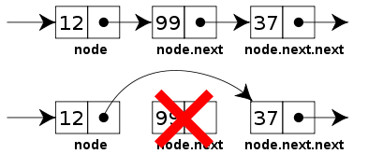
Linked List

Slide 20
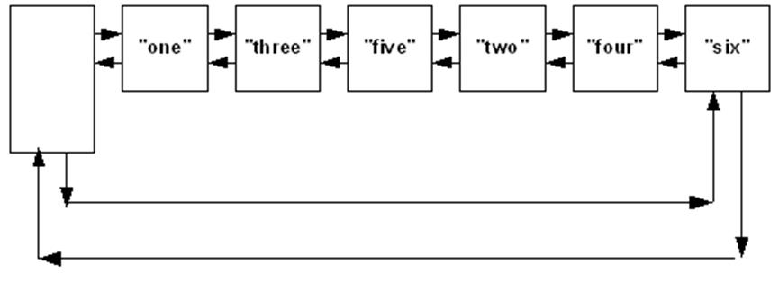
Doubly Linked List

Slide 21
LinkedList Example
List<String> list =
new LinkedList<String>();
list.add("Ali");
list.add("Taghi");
System.out.println(list.get(0));
list.remove("Taghi");
for (String string : list) {
System.out.println(string);
}

Slide 22
ArrayList vs. LinkedList
LinkedList stores two links for each element
if you want to do many insertions and removals in the middle of a list
  a LinkedList is better
If not, an ArrayList is typically faster

Slide 23
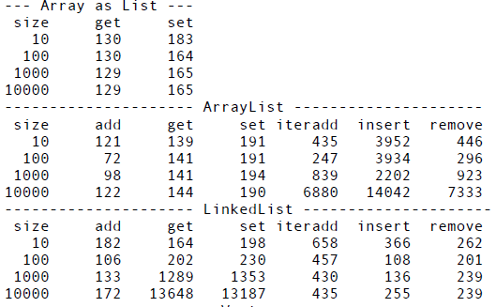
Array, ArrayList and LinkedList
Notes:
The "iteradd" test uses an iterator in the middle of the list to insert new elements.
The "insert" and "remove" tests both use location number 5 as the point of insertion or removal, rather than either end of the List.
the "add" test clears the List and then refills it to the specified list size

Slide 24
How to Test Performance?
long start = System.currentTimeMillis();
doSomthing();
long end = System.currentTimeMillis();
System.err.println(end - start);

Slide 25

Quiz!

Slide 26
Quiz
Implement a LinkedList<T> class
Support
  add
  remove
  get

Slide 27
Set

Slide 28
Set
A set is a an unordered list of disjoint elements
{1,2,3,1,4,2} = {4,3,2,1}
set.add(1)
set.add(2)
set.add(3)
set.add(1)
set.remove(1)
Set ➔ {3,2}

Slide 29
Set
A set is a list with no duplicate
Suppose we want to implement such a class
How?!

Slide 30
Set Implementation
class Set<E> extends ArrayList<E>{
public boolean add(E e) {
if(!contains(e))
return super.add(e);
return false;
};
public boolean add(int index, E e) {...}
}

Slide 31
Set and equals() Method
When set.add(value) is invoked
It checks whether there is any element equal to value
If any equal element found, add will return
We should implement appropriate equals() method
equals() is invoked implicitly

Slide 32
HashSet
Set is an interface
public interface Set<E>
extends Collection<E>
HashSet is one of its (popular) implementations
Set and HashSet are generic classes
public class HashSet<E>
implements Set<E>

Slide 33
HashSet Example
Set<String> set= new HashSet<String>();
set.add("Ali");
set.add("Taghi");
set.add("Ali");
for (String string : set) {
System.out.println(string);
}

Slide 34
HashSet Example
Set<Student> set= new HashSet<Student>();
set.add(new Student("Ali"));
set.add(new Student("Taghi"));
set.add(new Student("Ali"));
set.remove(new Student("Taghi"));
for (Student student : set) {
System.out.println(student);
}

Slide 35
Set or List?
List provides access via an index
  Set does not
List is ordered
Set checks for duplicates
  List is (usually) better in performance
  Set may be better in memory consumption
Should we allow duplicates?
  If not, use sets
HashSet is not implemented by a List

Slide 36
Map

Slide 37
Map
Map is not a collection
Map is a table
public interface Map<K,V>
Map<K, V> is something like a List<Pair<K,V>>
First element of each pair is called the key
Second element of each pair is called the value
Duplicate for keys is not allowed
Duplicate for values is possible

Slide 38
Map <K,V>
map.put(87300876, “Ali Alavi”)
map.put(87234431, “Taghi Taghavi”)
map.put(87300876, “Naghi Naghavi”)
87300876 | Ali Alavi
87300876 | Ali Alavi
87234431 | Taghi Taghavi
87300876 | Naghi Naghavi
87234431 | Taghi Taghavi

Slide 39
public interface Map<K,V> {
int size();
boolean isEmpty();
boolean containsKey(Object key);
boolean containsValue(Object value);
V get(Object key);
V put(K key, V value);
V remove(Object key);
void putAll(Map<? extends K, ? extends V> m);
void clear();
Set<K> keySet();
Collection<V> values();
Set<Map.Entry<K, V>> entrySet();
interface Entry<K,V> {
K getKey();
V getValue();
V setValue(V value);
}
}

Slide 40
HashMap
Map is an interface
public interface Map<K,V> {
HashMap is one of its (popular) implementations
public class HashMap<K,V>
implements Map<K,V>

Slide 41
HashMap Example
Map<Integer, String> map =
new HashMap<Integer, String>();
map.put(87300876, "Ali Alavi");
map.put(87234431, "Taghi Taghavi");
map.put(87300876, "Naghi Naghavi");
String name = map.get(87300876);
System.out.println(name);

Slide 42
Map<Student, Double> map = new HashMap<Student, Double>();
map.put(new Student("Ali Alavi"), new Double(18.76));
map.put(new Student("Taghi Taghavi"), new Double(15.43));
map.put(new Student("Naghi Naghavi"), new Double(17.26));
map.put(new Student("Naghi Naghavi"), new Double(15.26));
map.remove(new Student("Naghi Naghavi"));
Double average = map.get(new Student("Taghi Taghavi"));
System.out.println("Avg of Taghi=" + average);
for(Student student : map.keySet()){
System.out.println(student.toString());
}
Double totalSum = 0.0;
for(Double avg : map.values()){
totalSum += avg;
}
System.out.println("Total Average = " + (totalSum/map.size()));

Slide 43
Iterator

Slide 44
Iterator
Iterator is a mechanism for walking on elements of a collection
Before foreach (before Java5) it was the only mechanism
iterator() is declared in Iterable interface
In fact for-each is applicable on any Iterable object

Slide 45
Iterator
public interface Iterable<T> {
Iterator<T> iterator();
}
public interface Collection<E> extends Iterable<E> {…}

Slide 46
Iterator Class
public interface Iterator<E> {
boolean hasNext();
E next();
void remove();
}

Slide 47
Iterator Example
ArrayList<Integer> arrayList =
new ArrayList<Integer>();
arrayList.add(4);
arrayList.add(5);
for (Integer next : arrayList) {
System.out.println(next);
}
Iterator<Integer> iterator = arrayList.iterator();
while(iterator.hasNext()){
Integer next = iterator.next();
System.out.println(next);
}

Slide 48
Concurrent Modification
Suppose some processes are modifying the same collection
Java containers have a mechanism to prevent it
Suppose you’re in the middle of iterating through a container
And then some other process steps in and changes an object in that container
  Insert, remove, …
there are many scenarios for disaster.
  Maybe you’ve already passed that element in the container
  Maybe it’s ahead of you
  Maybe the size of the container shrinks after you call size( )

Slide 49
Fail Fast Aspect
If a collection is modified by one of its methods after an iterator is created for that collection
The iterator immediately becomes invalid
Any operations performed with the iterator after this point throw ConcurrentModificationExceptions
For this reason, iterators are said to be “fail fast”

Slide 50
ConcurrentModificationException
public class FailFast {
public static void main(String[] args) {
Collection<String> c =
new ArrayList<String>();
Iterator<String> it = c.iterator();
c.add("An object");
String s = it.next();
}
}
//Exception line

Slide 51
ConcurrentModificationException
ArrayList<Integer> list =
new ArrayList<Integer>();
list.add(1);
list.add(2);
list.add(3);
list.add(4);
for (Integer integer : list)
if(integer.equals(2))
list.remove(integer);
//Exception line

Slide 52
Arrays
A utility class with many useful static methods
For arrays
With methods for
  Copy
  Fill
  Sort
  Search
  …

Slide 53
Arrays
Long[] array = new Long[100];
Arrays.fill(array, 5);
Long[] copy = Arrays.copyOf(array, 200);
//An unmodifiable list:
List<Integer> asList =
Arrays.asList(1, 2 , 3, 4);
List<Long> asList2 = Arrays.asList(array);
Arrays.sort(array);

Slide 54
Collections
A utility class for collections
  Copy
  Fill
  Sort
  Search
  …

Slide 55
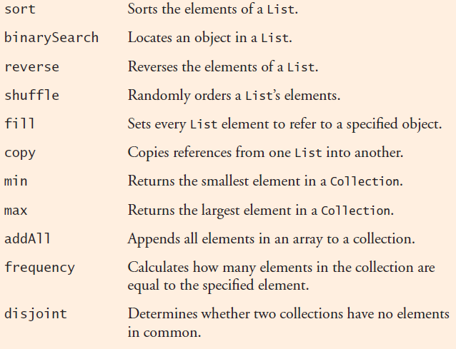
Collections

Slide 56
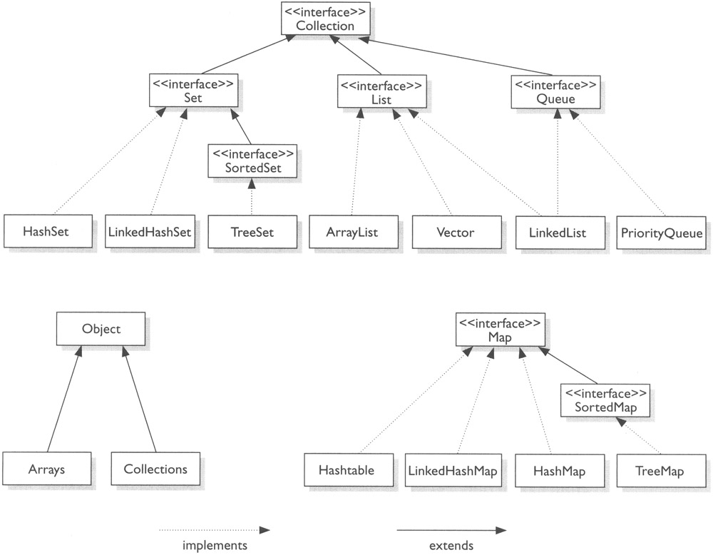
Other Containers

Slide 57
Quiz!

Slide 58
Quiz
Write the method
removeAlis(List<String> names)
It takes a List<String> as parameter
Removes all the elements which start with “Ali”
If(str.startsWith(“Ali”)){…}

Slide 59
Bad Implementation
static void removeAli(List<String> list){
for (String string : list)
if(string.startsWith("Ali"))
list.remove(string);
}
ConcurrentModificationException
Which line?

Slide 60
Good Implementation
public static void removeAli(ArrayList<String> list){
Iterator<String> iterator = list.iterator();
while(iterator.hasNext()) {
String string = iterator.next();
if(string.startsWith("Ali"))
iterator.remove();
}
}

Slide 61
Good Implementation
public static void removeAli(ArrayList<String> list){
for (Iterator<String> iterator = list.iterator(); iterator.hasNext();) {
String string = iterator.next();
if(string.startsWith("Ali"))
iterator.remove();
}
}
List<String> list = new ArrayList<String>(Arrays.asList("Ali", "AliReza", "Taghi"));
removeAli(list);

Slide 62
Another Correct Implementation
public static void removeAli(ArrayList<String> list){
for (int i = list.size()-1; i >= 0; i--)
if(list.get(i).startsWith("Ali"))
list.remove(i);
}

Slide 63
hashCode()
hashCode() is one of Object methods
  like equals, toString and finalize
It creates a hash from the object
Used in classes like HashMap and HashSet for faster retrieval

Slide 64


