Slide 1
An Introduction to Java Programming
www.javacup.ir
Sadegh Aliakbary

Slide 2
Copyright ©2014 JAVACUP.IR
All rights reserved.
Redistribution of JAVACUP contents is not prohibited if JAVACUP is clearly noted as the source in the used case.
JAVACUP shall not be liable for any errors in the content, or for any actions taken in reliance thereon.
Please send your feedback to info@javacup.ir

Slide 3
Agenda
JDBC
Connection
Statement
ResultSet
Transaction
RowSet

Slide 4
JDBC
JDBC API provides a standard database – independent interface to interact with RDMSs.
Typically, you use the JDBC API to connect to a database, query the data, and/or update data.
Using JDBC API relieves you of the effort to learn specific syntaxes for different databases.
Using JDBC API you write a query using standard SQL and the Java API processes the result in a database-independent manner.

Slide 5
JDBC
The collection of implementation classes that is supplied by a vendor to interact with a specific database is called a ‘JDBC driver’.
The ‘JDBC driver’ is used to connect to the RDMS.

Slide 6
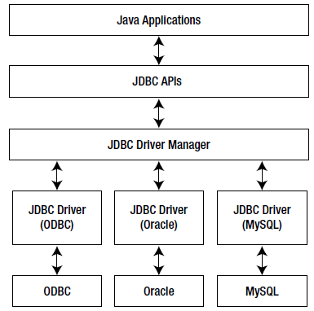
The Architecture of JDBC

Slide 7
JDBC Example
Class.forName("com.mysql.jdbc.Driver");
String SQL = "SELECT * FROM classes";
try (
Connection conn = DriverManager.getConnection(
"jdbc:mysql://localhost/cse3330a",
"root", "aSecret123");
Statement stmt = conn.createStatement();
ResultSet rs = stmt.executeQuery(SQL)
) {
while (rs.next()) {
System.out.println(rs.getString("prof"));
}
}

Slide 8
JDBC
To connect to a database:
Obtain the JDBC driver class files and add them to the CLASSPATH environment variable.
Register the JDBC driver with the ‘DriverManager’.
Construct a connection URL.
Use the static ‘getConnection()’ method of ‘DriverManager’ to establish a connection.

Slide 9
JDBC
To connect to our APACHE DERBY database:
// Register the JDBC driver class
String driver="org.apache.derby.jdbc.EmbeddedDriver";
Class.forName(driver);
// set up the database name
String dbName="jdbcDemoDB";
// define the Derby connection URL to use
String connectionURL = "jdbc:derby:" + dbName + ";create=true";
// establish the connection to the database.
conn = DriverManager.getConnection(connectionURL);

Slide 10
JDBC
You can execute different types of SQL statements using a JDBC driver.
We use different JDBC ‘statement’ objects depending upon the kind of SQL statement.
An instance of ‘java.sql.Statement’ interface represents a SQL statement in a java program.
three interfaces to represent SQL statements:
Statement
Prepared Statement
Callable Statement

Slide 11
JDBC
a ‘Statement’ object: SQL statement in the form of a string
These SQL statements are compiled each time they are executed.
‘PreparedStatement’ object: pre-compile a SQL statement once and execute it multiple times
Lets you specify a SQL statement in the form of a string that uses placeholders.
You supply the values of the placeholders before executing the statement.
‘CallableStatement’ object: for a stored procedure or function in a database

Slide 12
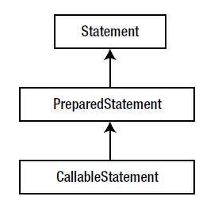
Statements

Slide 13
JDBC
To execute a SQL statement using a ‘Statement’ object:
Get a connection object.
Connection conn = … (get a Connection object)
Use the connection object to create a ‘Statement’ object:
Statement stmt = conn.createStatement();

Slide 14
JDBC
Set up your SQL in a string:
String sql = “update person set income=income*1.1”;
4. Execute the statement by calling one of the ‘execute’ methods of the ‘Statement’ object:
int rowsUpdated = stmt.executeUpdate(sql);
Close the ‘Statement’ object to release resources:
stmt.close();
Commit the transaction to the database:
conn.commit();

Slide 15
‘Statement’ interface
‘execute()’ method
is used to execute a SQL statement which does not return a value,
such as ‘CREATE TABLE’.
‘executeUpdate()’ method
is used for SQL that updates a database,
as in ‘INSERT’, ‘UPDATE’ and ‘DELETE’ SQL statements.
It returns the number of rows affected.
‘executeQuery()’
is used for SQL that produces a resultset,
as in ‘SELECT’ SQL statements.

Slide 16
JDBC
the ‘auto-commit’ property for the ‘Connection’ object
is set to ‘true’ by default.
If a ‘Connection’ is not in auto-commit mode, you must call the ‘commit()’ or ‘rollback()’ method of the ‘Connection’ object to commit or rollback the transaction

Slide 17
JDBC
try {
Connection conn = get the connection…
conn.setAutoCommit(false);
Statement stmt = conn.createStatement();
String sql = “update person set income=income*1.1”;
int rowsUpdated = stmt.executeUpdate(sql);
stmt.close();
conn.commit();
conn.close();
}
catch (SQLException e)
{ conn.rollback(); e.printStackTrack(); conn.close();}

Slide 18
PreparedStatements
String sql = “insert into person” +
“person_id,first_name,last_name,gender,”+
”values (?,?,?,?,?,?)”;
PreparedStatement pstmt = conn.preparedStatement(sql);
pstmt.setInt(1,801);

Slide 19
Prepared Statements, Parameters
String sql = “insert into person” +
“person_id,first_name,last_name,gender,”+
”values (?,?,?,?,?,?)”;
Connection conn = get a connection object…;
Prepared Statement pstmt = conn.prepareStatement(sql);
pstmt.setInt(1,801);
pstmt.setString(2,”Tom”);
pstmt.setString(3,”Baker”);
pstmt.setString(4,”M”);
java.sql.Date dob = java.sql.Date.valueOf(“1970-01-25”);
pstmt.setDate(5,dob);
pstmt.setDouble(6,45900);
pstmt.executeUpdate();

Slide 20
ResultSet
a ‘SELECT’
‘ResultSet’.
the data arranged in rows and columns.
The ‘Statement’ or ‘PreparedStatement’ or ‘CallableStatement’ object returns the result of a query as a ‘ResultSet’ object

Slide 21
JDBC
You can get information about the properties of a ‘ResultSet’ supported by a JDBC driver by using methods of the ‘DatabaseMetaData’ interface.
First we get a ‘DatabaseMetaData’ object as follows:
Connection conn = get a connection….
DatabaseMetaData dmd = conn.getMetaData();

Slide 22
JDBC
Some additional ‘DatabaseMetaData’ methods:
String dbName = dmd.getDatabaseProductName();
String dbVersion = dmd.getDatabaseProductVersion();
String driverName = dmd.getDriverName();
String driverVersion = dmd.getDriverVersion();

Slide 23
JDBC
ResultSet rs = stmt.executeQuery(sql);
While (rs.next())
{
//process the current row in rs…
}
//done with the ResultSet rs.

Slide 24
ResultSet, get methods
A ‘ResultSet’ object lets you read the value of a column from its current row using one of the ‘getXXX()’ methods, where ‘XXX’ is the data type of the column.(e.g. ‘getInt()’, ‘getString()’)
You must specify the index of column name in the ‘getXXX()’ method whose value you want to read.
int personID = rs.getInt(“person_id”);
String firstName = rs.getString(2);

Slide 25
JDBC
Connection conn = get a Connection object …
Statement stmt = conn.getStatement();
String sql = “select person_id, first_name,”+
“last_name,dob,income from person”;
ResultSet rs = stmt.executeQuery(sql);
while (rs.next()) {
int personID=rs.getInt(1);
String firstName=rs.getString(2);
String lastName = rs.getString(3);
java.sql.Date dob = rs.getDate(4);
double income = rs.getDouble(5);
//do something with the retrieved values from the cols.
}

Slide 26
JDBC
You can close a ‘ResultSet’ object by calling its ‘close()’ method.
rs.close();
Closing the ‘ResultSet’ frees the resources associated with it.
When the ‘Statement’ object that produces the ‘ResultSet’ object is closed, it automatically closes the ‘ResultSet’ object.

Slide 27
ResultSet Cursor Methods
void beforeFirst()
Sets the cursor just before the first row in the ResultSet.
void afterLast()
Sets the cursor just after the last row of the ResultSet.
boolean absolute(int rowNumber)
Sets the cursor to the requested row number absolutely.
boolean relative(int rowNumber)
Sets the cursor to the requested row number relatively.
boolean next()
Sets the cursor to the next row of the ResultSet.
boolean previous()
Sets the cursor to the previous row of the ResultSet

Slide 28
JDBC
The interface ‘RowSet’ from the ‘javax.sql’ package is a wrapper for ‘ResultSet’ and inherits from the ‘ResultSet’ interface.
A ‘RowSet’ allows for simpler JDBC programming. You need not deal directly with ‘Connection’ and ‘Statement’ objects, all you need to work with is the ‘RowSet’ object.

Slide 29
JDBC
The ‘javax.sql.RowSet’ package defines five interfaces which inherit from the ‘RowSet’ interface
Therefore, all the methods of the ‘ResultSet’ interface are available in these five types of rowsets.
Typically, database vendors provide implementation classes for the five types of rowsets.

Slide 30
JDBC
The five types of rowsets are:
JdbcRowSet
CachedRowSet
WebRowSet
FilteredRowSet
JoinRowSet

Slide 31
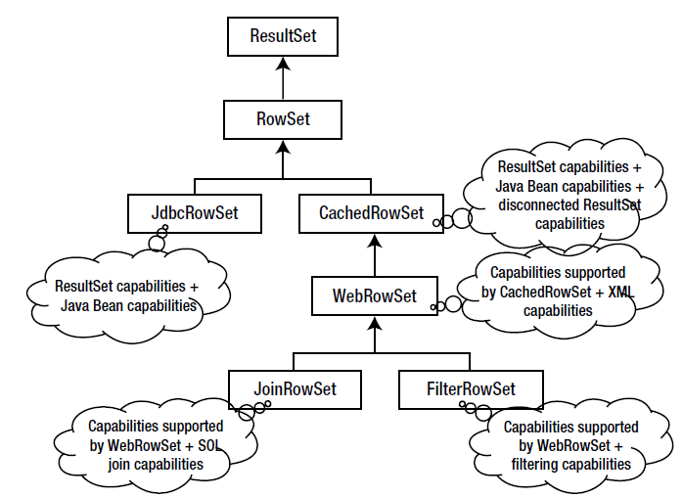

Slide 32
JDBC
try
{
RowSetFactory rsf = RowSetProvider.newFactory();
JdbcRowSet jrs = rsf.createJdbcRowSet();
//… work with the JdbcRowSet…
}
catch (SQLException e)
{
e.printStackTrace();
}

Slide 33
JDBC
RowSet rs = … get a RowSet object …
String sql=“select person_id,first_name”+
“last_name from person”;
rs.setCommand(sql);

Slide 34
JDBC
RowSet rs = … get a RowSet object …
String sql=“select person_id,first_name”+
“last_name from person”+
“where income between ? and ?”;
rs.setDouble(1,20000.0);
rs.setDouble(2,40000.0);
rs.setCommand(sql);

Slide 35
JDBC
A ‘RowSet’ inherits all cursor movement methods from the ‘ResultSet’ interface.
By default, all ‘RowSet’ objects are bi-directional scrollable and updateable.
rs.execute();
while (rs.next()) {
int personID = rs.getInt(“person_id”);
String firstname=rs.getString(“first_name”);
}

Slide 36
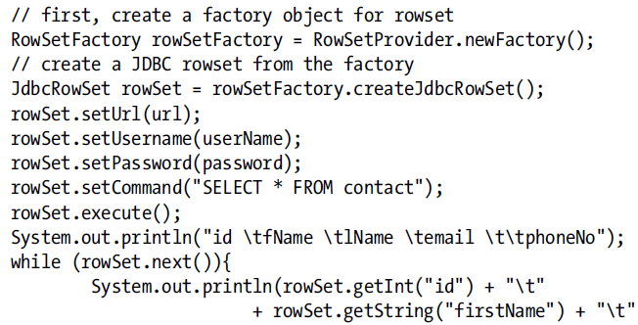
RowSet Example

Slide 37
DAO
// Main.java
public class Main
{
public static void main( String[] args)
{
Student student = new Student( ... );
StudentDAO studentDAO = new OODBMSDAO();
studentDAO.insertStudent(student);
}
}

Slide 38
StudentDAO
// RDBMSDAO.java
public class RDBMSDAO implements StudentDAO
{
public void insertStudent( Student student){
// insertStudent implementation
}
public Student findStudent( int id){
// findStudent implementation
return Student;
}
public void deleteStudent( int id) {
// deleteStudent implementation
}
}

Slide 39
Further Readings
DAO and Generic DAO patterns
JDBC+Spring
DataSource, RowMapper, JdbcTemplate, …
ORM
Hibernate
CQRS Pattern
Separate reporting db
Datawarehousing
NoSQL

