Slide 1
An Introduction to Java Programming
www.javacup.ir
Sadegh Aliakbary

Slide 2
Copyright ©2014 JAVACUP.IR
All rights reserved.
Redistribution of JAVACUP contents is not prohibited if JAVACUP is clearly noted as the source in the used case.
JAVACUP shall not be liable for any errors in the content, or for any actions taken in reliance thereon.
Please send your feedback to info@javacup.ir

Slide 3
Agenda
i18n
Localization
Resource Bundles
Formatting
Numbers
Dates
…

Slide 4
Internationalization (i18n)
the process of designing and writing an application
so that it can be used in a global or multinational context
An internationalized program is capable of supporting different languages,
as well as date, time, currency, and other values,
without software modification

Slide 5
Internationalization (continued)
"Internationalization is :
the process of designing software
so that it can be adapted (localized) to various languages and regions easily, cost-effectively,
and in particular without engineering changes to the software
This generally involves isolating the parts of a program that are dependent on language and culture…

Slide 6
Localization (L10n)
"Localization is:
the process of adapting a program for use in a specific locale
A locale is a geographic or political region that shares the same language and customs.
Localization includes the translation of text
such as user interface labels, error messages, and online help
It also includes the culture-specific formatting of data items
such as monetary values, times, dates, and numbers

Slide 7
First Steps of Internationalization
Extract translatable text from code
Load resources for a specific locale
Inject locale specific resources into the application

Slide 8
Java Internationalization: ResourceBundle
ResourceBundle is the basis of Java internationalization
Backed by different data stores
Property files (PropertyResourceBundle)
Java source code (ListResourceBundle)
Represents a collection of key/value pairs for a given locale
Notes:
ResourceBundle is the Java internationalization implementation that loads resources for a given locale and is the entry point through which resources can be retrieved. Think of it as a glorified hash map that is loaded by differing backing stores. The PropertyResourceBundle actually is a hash map.
Show the ResourceBundle interface and the two implementations as well as the getKeys and handlGetObject methods that must be implemented. Also note the extra getContents method on the ListResourceBundle. And on the PropertyResourceBundle show that the constructor just loads the properties file into a hash map and then operates on that map.

Slide 9
For example
Property file(s)
Accessing the resource
#bundle.properties
abc=some string
#bundle_it.properties
abc=some Italian string
ResourceBundle.getBundle("bundle").getString("abc") ; //some string
ResourceBundle.getBundle("bundle", Locale.ITALIAN).getString("abc") //some Italian string

Slide 10
Example (2)

Slide 11
Localizing Text
Text is obviously the main aspect to be localized
Other aspects: audio, …
Many aspects are handled differently based on the locale:
date and time, numbers, and currencies
Format base class

Slide 12
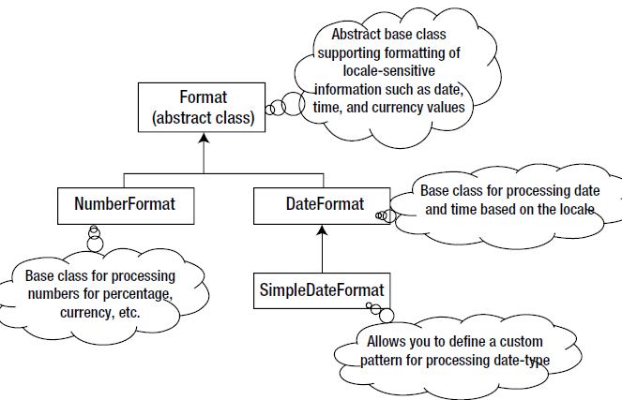

Slide 13
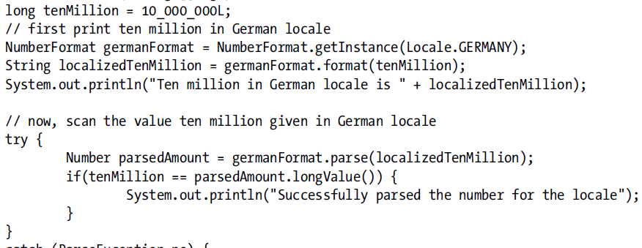
The NumberFormat Class

Slide 14
The Currency Class

Slide 15
The DateFormat Class

Slide 16
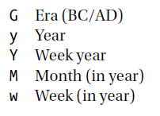
SimpleDateFormat

Slide 17
Design Hint
isolating the parts of a program that are dependent on others
Dependent on local ➔ resource bundles
Other dependencies?
Rules
Work-flows
Configurations
Server, DB, …

